Slide 1



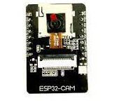
Final Presentation ESP32-cam door security system
Students: Yael Tzadik, Eden Ishay
Supervisor: Johanan Erez
Context: Project A
Date: 5/2024
[Optional Picture]
Notes:
יעל

Slide 2
Presentation Outline
Overview of the component-ESP32 Camera
Existing Projects
Available IDEs
Our Algorithm outline
Rejected ideas
Future Work Suggestion
Notes:
יעל

Slide 3
Project Goal
Building a facial recognition system for opening doors based on existing algorithms.
Developing anti spoofing algorithm using the existing hardware in the ESP32-cam component.
Performance evaluation of ESP32CAM in the context of image processing.
Making the system independent and reliable.
Notes:
עדן

Slide 4
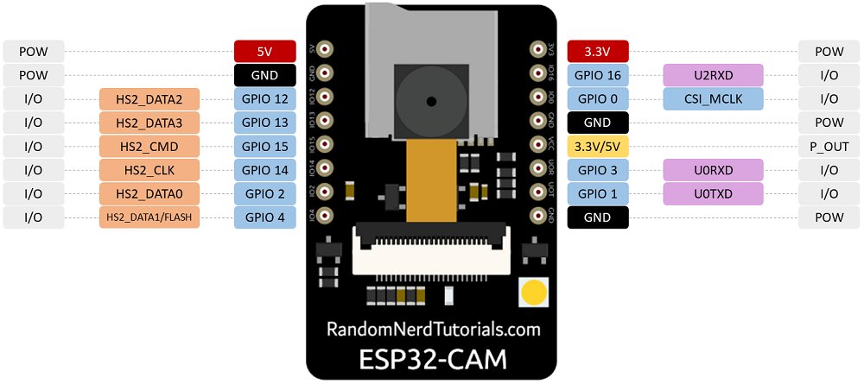
ESP32-Camera device
520KB SRAM +4M PSRAM | RAM
802.11 b/g/n/ | Wi-Fi
Maximum support 4G | Support TF card
JPEG( OV2640 support only ), BMP, GRAYSCALE | Image Output Format
2412 ~2484MHz | Spectrum Range
Notes:
יעל – תומך בוויפי ובלוטוט אבל לא במקביל

Slide 5
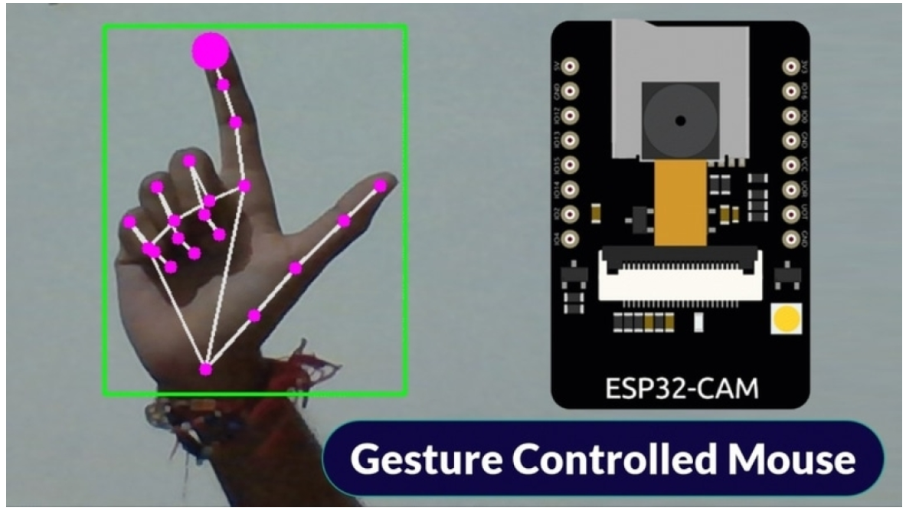
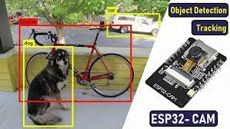
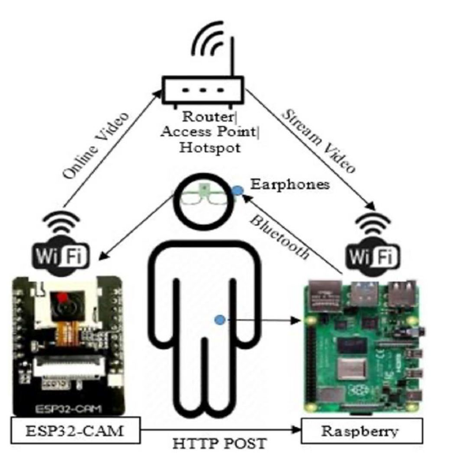
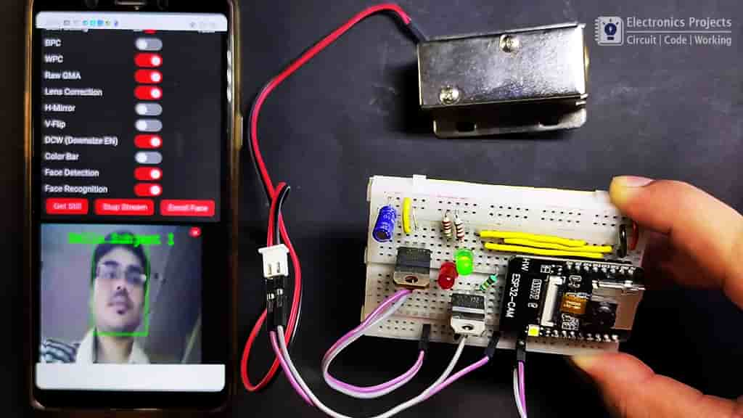
Existing Projects
Projects using the PC and ESP-32 as camera
Projects using Raspberry Pi and ESP-32 as camera
Esp32-cam Example project
Notes:
יעל – פרוייקטים מתחלקים ל 3 קטגוריות

Slide 6
Optional Solutions
Most projects use the calculation capabilities of an external computer rather than the component itself.
Pro’s:
The accuracy of the face detection/recognition is high
The calculation time is low
Large memory storage space
Con’s:
Lack of independence, dependence on external computer
High cost
Notes:
עדן

Slide 7
Optional Solutions
Face recognition systems- There are many examples and projects of face recognition systems such as:
Fisher Faces
Eigen Faces
MTMN
Notes:
עדן ואז יעל

Slide 8
Optional Solutions
Anti spoofing:
Smile Detection
Blink detection
Screen detection
Deep learning-based models
Suspicious object detection
Stereo camera
Notes:
יעל ואז עדן

Slide 9
Available IDEs
Arduino IDE
Espressif ESP-IDF
Well known environment
Support for the basic libraries of the component
Does not support significant image processing libraries
Extension to VS Code or Eclipse IDE
Relatively new, more flexible to programing IDE
Theoretically supports the basic libraries of the component and the OpenCV library
Notes:
יעל – להסביר ש open cv לא עובד. הספרייה המוקטנת שקיימת לכאורה נועדה בעצם לרכיב אחר

Slide 10
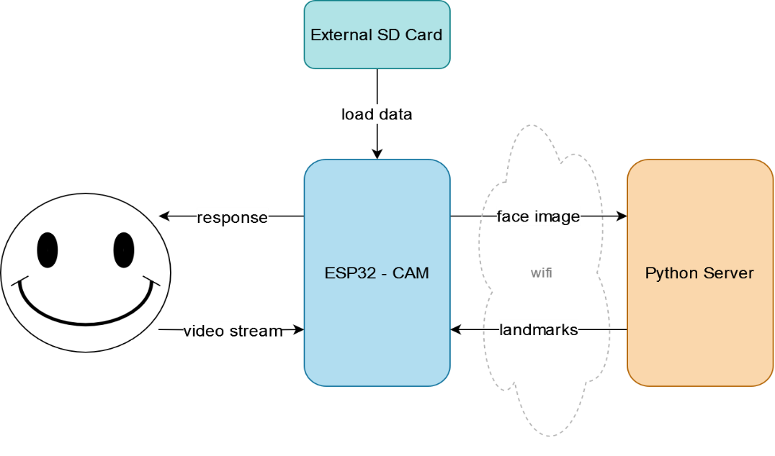
Chosen solution: Block Diagram
Notes:
עדן

Slide 11
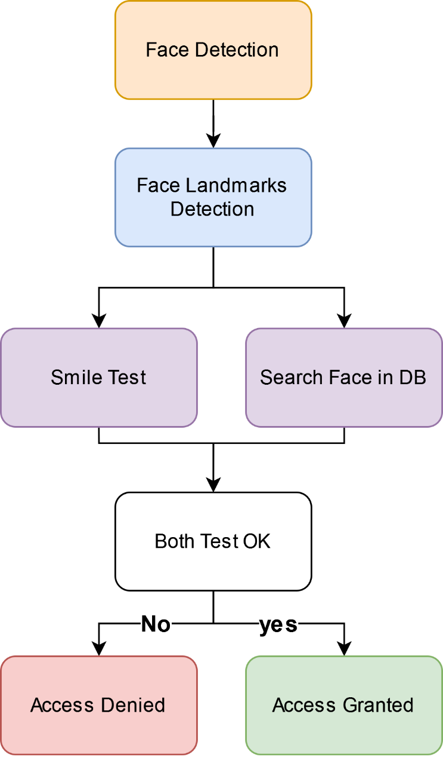
Chosen solution: Flow Diagram
Notes:
יעל
גראסאות מתקדמות משתמשות בויולה גונס הגרסה הישנה משתמשת ב MTMN
חייב רצף קבוע של פנים בתמונה

Slide 12

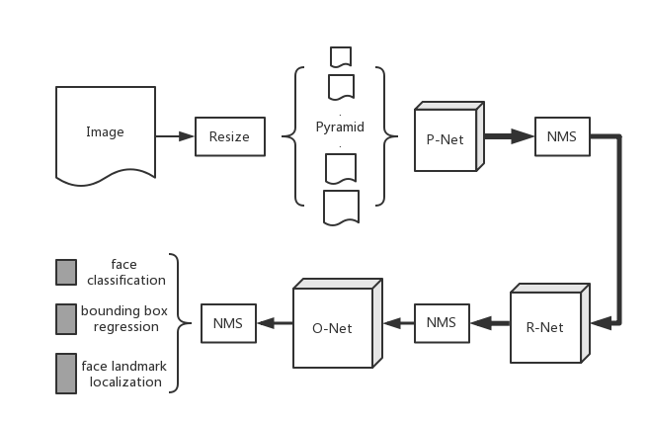
Chosen solution: details
Face Detection
MTMN - A reduced model for human face recognition, which is built with the MobileNetV2 and MTCNN architectures and designed specifically for small devices.
MTMN consists of three main parts:
Proposal Network (P-Net): Proposes candidate bounding boxes.
Refine Network (R-Net): Screens the bounding boxes from P-Net.
Output Network (O-Net): Outputs the accurate bounding box, confidence coefficient and 5-point-landmark.
Notes:
עדן
Multi task cascades neural network – 96% accuracy
MobileNetV2 by google

Slide 13
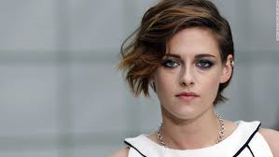
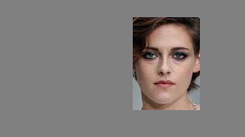
Chosen solution: details
Face Detection
Reducing image size using JPEG-
After face detection, we improve sending time by reducing the image data using JPEG algorithm.
The file size is reduced by 65%.
0x808080
Notes:
עדן

Slide 14
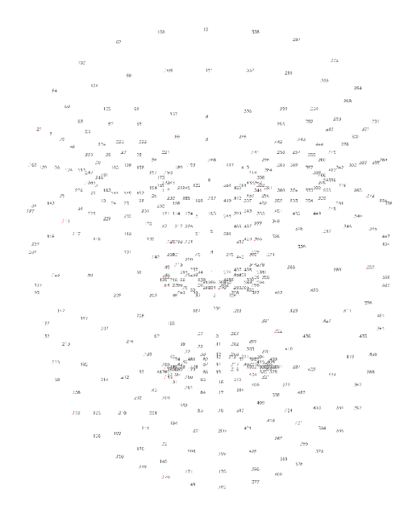
Chosen solution: details
Face Landmarks Detection
FaceMesh was chosen for Extracting face landmark points because it produced 468 landmarks which are more accurate and flexible in choosing fewer landmark according to the comparison algorithm.
Notes:
יעל
Yu-jin hong
אלגוריתם של Media pipe האפשרות השנייה היא OPENFACE של opencv

Slide 15

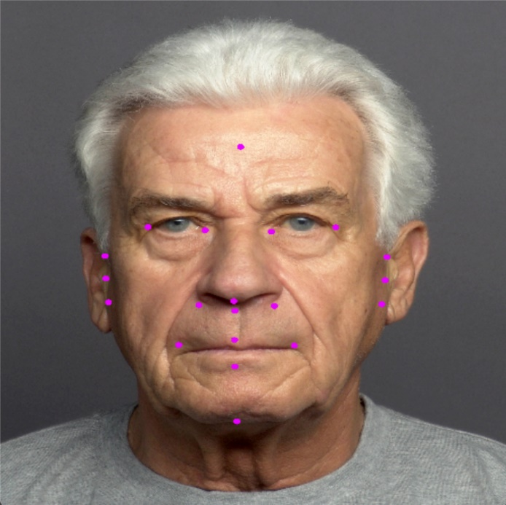
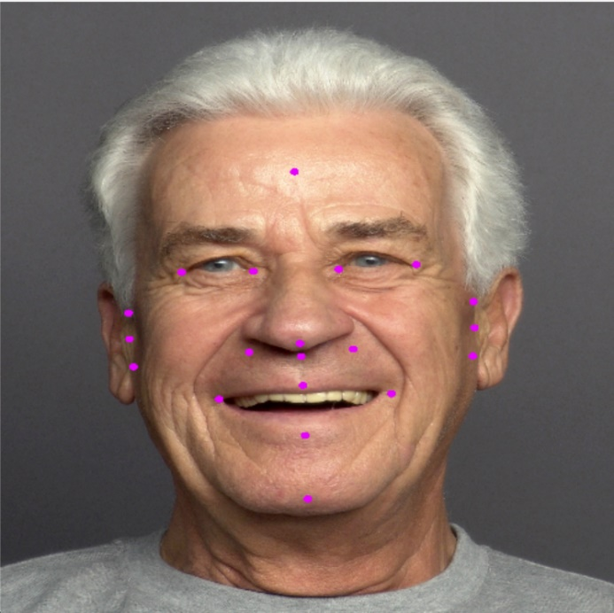
Chosen solution: details
Smile Test
Detecting smiles by analyzing the changing distance ratios among facial landmarks over a duration of 20 frames.
Notes:
עדן

Slide 16
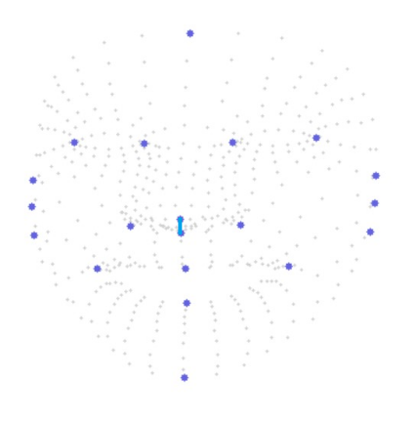
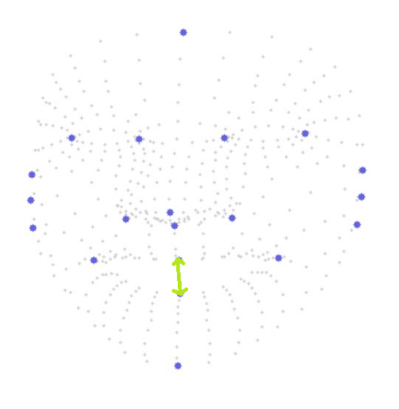
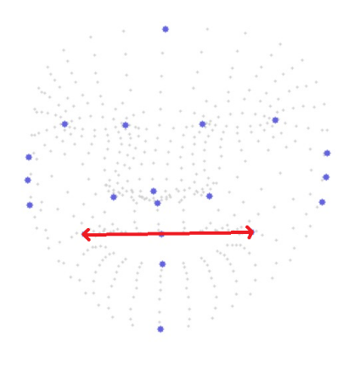
Chosen solution: details
Smile Test
Normalize the distances of the points using fixed nose points as reference (blue),
Detect:
20% increase in horizontal distance (red)
100% increase in vertical distance (green)
Results were above 93% accuracy.

Slide 17
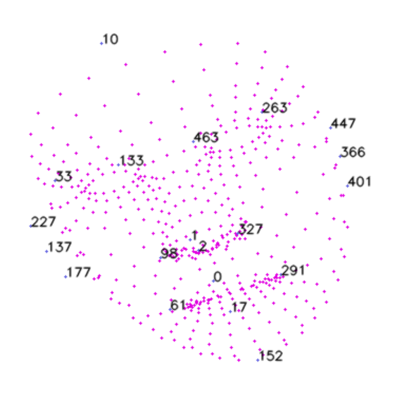
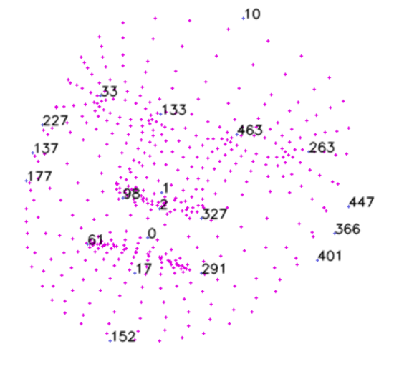
Chosen solution: details
Search in DB
The algorithm computes the distance from each point to the nose center and subsequently compares this distance vector to the database. Consequently, the algorithm remains unaffected by head tilting.
Our Algorithm | Existing Algorithm
20 landmark points | 5 landmark points
>100 subjects | 7 subjects limit
Notes:
יעל

Slide 18
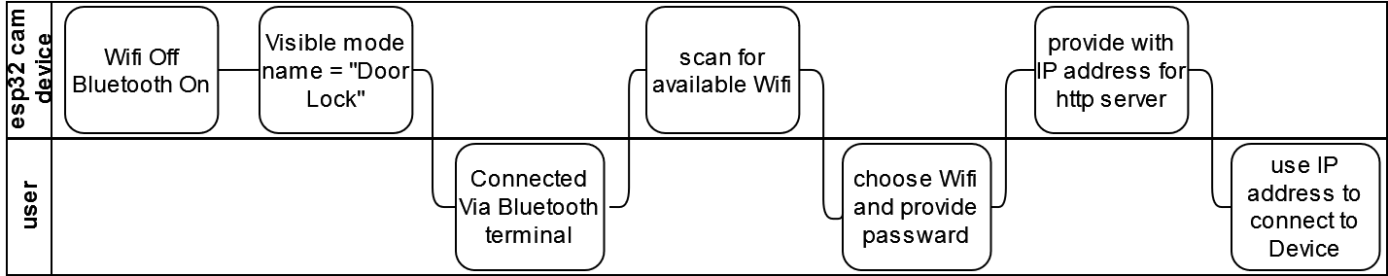
Connecting ESP32-cam to Net
When starting the system or restarting it, a Bluetooth connection named “Door Lock” is available.
The ESP32-CAM can be communicated through Bluetooth terminal
Notes:
עדן

Slide 19
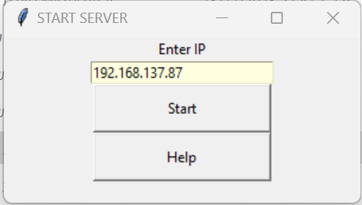
Connecting ESP32-cam to PC
To connect ESP32-cam to the PC the server require the IP address of the component.
The IP address is given after the Bluetooth connection.
Notes:
המשך עדן

Slide 20
Results
Our algorithm |  | Original algorithm – ESP WHO
468 landmarks | 20 landmarks
84% | 60% | 34% | Face recognition success rate
15% | 45% | 83% | Face recognition false positive rate
80% | 100% | 100% | Face recognition true positive rate
Notes:
יעל
יש שיפור משמעותי בחסימת פורצים!

Slide 21
Rejected ideas
Reducing the Image dimensions by cutting it.
Sorting the database according to eye color.
Detecting returned flash from screen.
Using different angels for depth distances.
Recognition of square objects using Hough transform.
Notes:
עדן
RANSAC
למה לא צבע עניים
זיהוי פלאש בעייתי

Slide 22
Future Work Suggestion
Develop more anti spoofing to our project using a new stronger device.
Changing the distance comparison algorithm to a more complicate one.
Creating a system using a couple of ESP32-camera devices as input only to a strong computing device.
Notes:
יעל

Slide 23
The END

